Slide 1


Hospital at Home

Slide 2

Atrium Health Hospital at Home
Implemented in March 2020 in response to the pandemic-induced inpatient capacity crisis…just 10 days from initial concept to first patient admitted
Leveraged existing resources and expertise from across the System to build and scale Hospital at Home to Mecklenburg and 10 surrounding counties
49% of patients live in rural zip codes
Implemented the CMS Acute Care at Home Waiver in March 2021 (now 10 facilities)
NC Medicaid began covering H@H on November 1, 2023
Largest H@H program in the US having served 8,500 patients to date… Average Daily Census 41

Slide 3

Why Hospital at Home?
Driving Forces
Patients prefer to be at home
Aging, polychronic population
Hospitals’ ongoing capacity challenge
Inherent risks of hospitalization (falls, HAC, etc.)
Health Inequities/ Access to Care
SDOH impact 80% of patients’ well-being
Current care models cost too much
H@H Deliverables
Care delivered in familiarity & comfort of home
Holistic, multidisciplinary team-based care
Avoided B&M admissions and decreased LOS
Fewer falls, HAIs, delirium, immobility, insomnia
Expanded access & support, both urban and rural
SDOH identified and addressed in real time/place
Lower cost for providers, payers and patients
Hospital at Home

Slide 4







Hospital at Home Scope of Services
Remote Patient Monitoring
2-way audio/video connectivity
24/7 Virtual RN Assessment & Monitoring
Twice daily
in-home Community Paramedic or RN Visit
Daily Virtual Visit with Provider
IV Infusion/ Meds, Oxygen, Resp Care & other therapies
EKG
Labs

Slide 5

Target Populations and Conditions
Chronic Condition Exacerbation
Congestive Heart Failure
COPD/ Asthma
Diabetes
Hypertensive Urgency
Acute/Episodic Conditions
Cellulitis
Pyelonephritis
DVT
CAP
PE
COVID now approx. 5%

Slide 6
Outcomes
Operations
Total Unique Patients: Nearly 8,500
Total B&M Days Avoided: nearly 30,000
ALOS: 4.0
Quality
Readmissions O/E: 0.80
Mortality: <1%
Return to B&M: 5.0%
Patient Experience
Overall Rating: 84.7% (B&M: 71.8%)
Likely to Recommend: 88.3% (B&M: 75.8%)

Slide 7
Finding Our Way Through Uncharted Territory
Federal Legislation
Worked through Govt Relations team and other coalitions to educate and influence Congress to pass CMS Waiver extension…passed as part of end of year Omnibus package - extends Waiver through end of 2024
State DHSR and DHHS
Granted temporary licensed virtual inpatient beds in Dec 2020 in alignment with CMS Acute Care at Home Waiver and NC capacity waivers
DHSR has allowed continued use of beds through end of federal PHE… as of 5/19, bill passed to allow continued use of inpatient licensed beds for H@H through end of 2024
As a CON state, permanent H@H IP bed licensure will require legislative action
NC Medicaid began funding as of November 1, 2023
Accreditation
Joint Commission not currently surveying H@H programs; new standards contingent on any revisions to Hospital CofP.

Slide 8
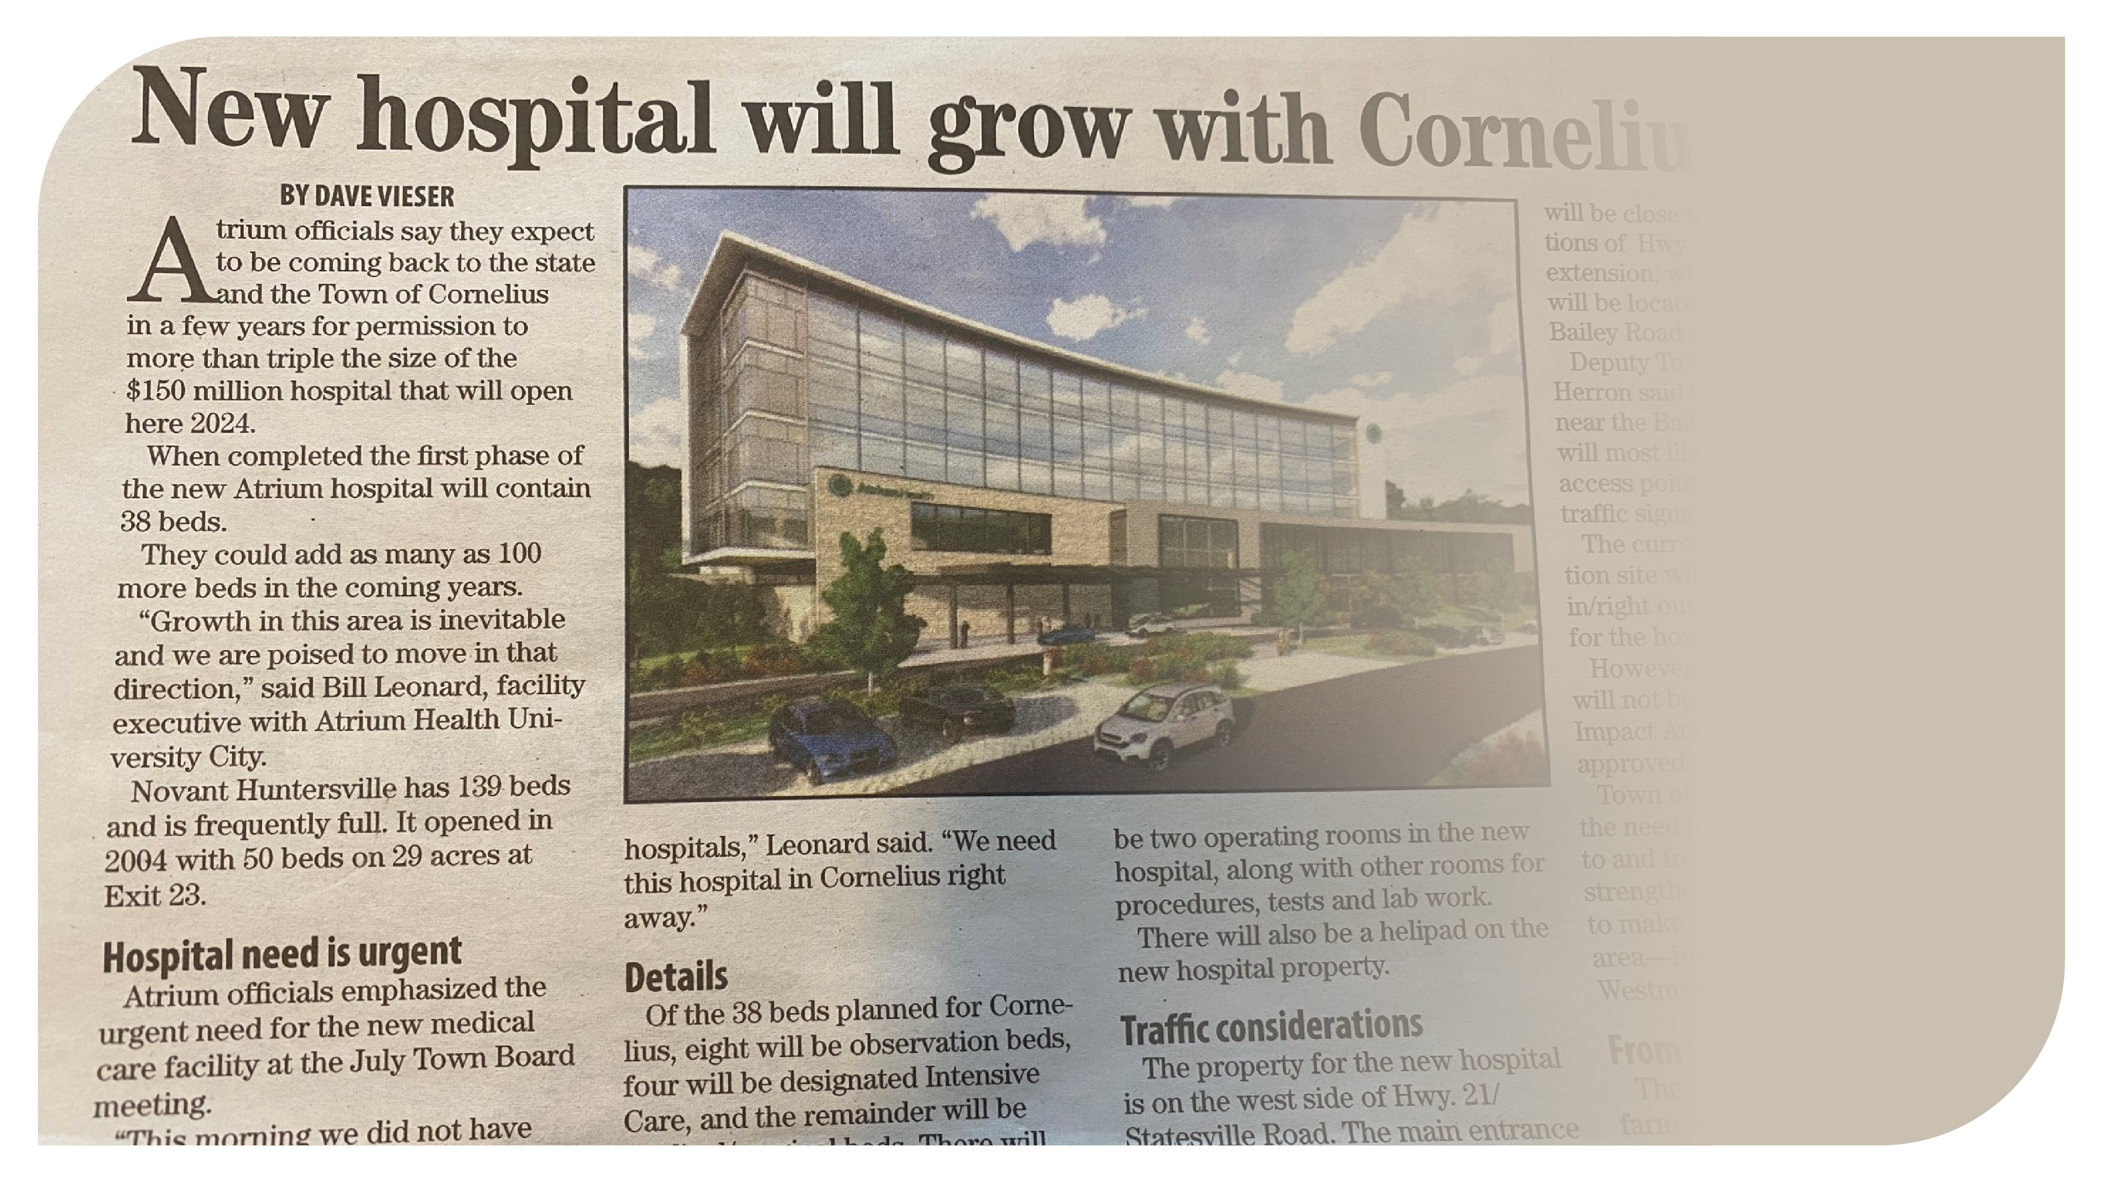
“We can’t build enough beds to cover the need in this growing market”
(Senior level Finance Leader)
Cornelius Today

Slide 9
The plan “Go Big and Go Home”
Scale to make meaningful system impact on capacity
Scale program to 100 beds (5% of GCR IP beds) over next 12-18 months
Pivot program to OP service to provide “hospital-level care” with more operational and billing flexibility
Invest in technology and infrastructure to optimize program
Implement RPM solution
Build permanent workforce, equipment and supply chain infrastructure
Develop Commercial Payer Strategy
Proactively engage payers regarding H@H coverage
Develop 30-day Episode of Care/ Bundle payment model among other payer-specific contract options (discounted DRG, % of charges, bundle, etc.)
Define Enterprise Leadership, Structure & Accountability
Define H@H reporting structure and accountabilities
Continue WFB collaboration for H@H and Transition Services
Align and integrate H@H with broader home-based services to create a seamless patient experience and maximize synergies and efficiencies

Slide 10
Thank you!

